Slide 1
Additional Notes
Inflation, Unemployment, Business Cycles

Slide 2
Inflation and Deflation
Causes and Consequences

Slide 3
Inflation happens when the price of goods and services increase, while deflation takes place when the price of the goods and services decrease in the economy. Inflation and deflation are the opposite sides of the same coin.
Maintaining the balance between these two economic conditions, i.e. inflation and deflation is essential as the economy can quickly swing from one condition to the other, resulting in imbalances.
The Reserve Bank of India keeps an eye on the levels of price changes and controls deflation or inflation by conducting its monetary policy operations, such as setting interest rates in India.

Slide 4
INFLATION
Inflation is the rate at which the prices for goods and services increase. Inflation often affects the buying capacity of consumers. Most Central banks try to limit inflation in order to keep their respective economies functioning efficiently. There are certain advantages as well as disadvantages to inflation.
Inflation refers to the increase in the prices of the goods and services of daily use, such as food, housing, clothing, transport, recreation, consumer staples, etc. Inflation is measured by taking into consideration the average price change in a basket of commodities and services over a period of time.
Inflation is calculated in India by the Ministry of Statistics and Programme Implementation (MoSPI) and is closely monitored by RBI.

Slide 5
A simple example would be, suppose a kg of apple cost Rs.100 in 2019 and it cost Rs.110 in 2020, then there would be a 10% increase in the cost of a kg of apple.
In the same way, many commodities and services whose prices have increased over time are put in a group and the percentage is then calculated by keeping a year as the base year.
The percentage of increase in prices of the group of commodities is then the rate of inflation.

Slide 6
Inflation measures the average price change in a basket of commodities and services over time.
Inflation is indicative of the decrease in the purchasing power of a unit of a country’s currency (Disadvantage of Inflation)
This could ultimately lead to a deceleration in economic growth.
However, a moderate level of inflation is required in the economy to ensure that production is promoted (Advantage of Inflation). Inflation is an incentive for producers.
In India, inflation is primarily measured by two main indices — WPI & CPI which measure wholesale and retail-level price changes, respectively.

Slide 7
Causes of Inflation
Inflation is caused by multiple factors, here are a few:
1) Money Supply:
Excess currency (money) supply in an economy is one of the primary causes of inflation. This happens when the money supply/circulation in a nation grows above the economic growth, therefore reducing the value of the currency.

Slide 8
2) National Debt
There are a number of factors that influence national debt, which include the nation’s total borrowing and spending.
In a situation where a country’s debt increases, the respective country is left with two options:
- Taxes can be increased internally.
- Additional money can be printed to pay off the debt.

Slide 9
3) Demand-Pull Effect
The demand-pull effect states that in a growing economy as wages increase within an economy, people will have more money to spend on goods and services.
The increase in demand for goods and services will result in companies raising prices that the consumers will bear in order to balance supply and demand.
4) Cost-Push Effect
This theory states that when companies face increased input cost on raw materials and wages for manufacturing consumer goods, they will preserve their profitability by passing the increased production cost to the end consumer in the form of increased prices.

Slide 10
4) Exchange Rates
An exchange rate is a relative price of one currency expressed in terms of another currency (or group of currencies).
Eg: 1 US$ = Rs. 82
When a large fraction of a country’s trade is denominated in foreign currencies, its rate of inflation is more strongly affected by exchange-rate fluctuations.
When inflation is higher, this tends to have a depressing affect on the value of a country’s currency. This is because increased inflation reduces the currency’s buying power, which weakens it against other currencies.

Slide 11
Effects of Inflation
When there is inflation in the country, the purchasing power of the people decreases as the prices of commodities and services are high. The value of currency unit decreases which impacts the cost of living in the country. When the rate of inflation is high, the cost of living also increases, which leads to a deceleration in economic growth.
However, a healthy inflation rate (2-4%) is considered positive because it directly results in increasing wages and corporate profitability and maintains capital flowing in a growing economy.

Slide 12
Deflation
Deflation is generally the decline in the prices for goods and services that occur when the rate of inflation falls below 0%.
Deflation will take place naturally, if and when the money supply of an economy is limited. Deflation in an economy indicates deteriorating economic conditions.
Deflation is normally linked with significant unemployment and low productivity levels of goods and services.
The term “Deflation” is often mistaken with “disinflation”. While deflation refers to a decrease in the prices of goods and services in an economy, disinflation is when inflation increases at a slower rate.

Slide 13
Causes of Deflation
Structural changes in capital markets
When different companies selling similar goods or services compete, there is a tendency to lower prices to have an edge over the competition.
Increased productivity
Innovation and technology enable increased production efficiency which leads to lower prices of goods and services. Some innovations affect the productivity of certain industries and impact the entire economy.
Decrease in the supply of currency
The decrease in the supply of currency will decrease the prices of goods and services to make them affordable to people.

Slide 14
Effects of Deflation
Deflation may have the following impacts on an economy:
Reduction in Business Revenues
In an economy faced with deflation, businesses must drastically reduce the prices of their products or services to stay profitable. As reductions in prices take place, revenues begin to drop.
Lowered Wages and Layoffs
When revenues begin to drop, businesses need to find means to reduce their expenses to meet objectives. One way is by reducing wages and cutting jobs. This adversely affects the economy as consumers would now have less to spend.

Slide 15
Types of Inflation
Cost-Push Inflation: inflation due to rise in the prices of factors of production or inputs.
Demand-Pull Inflation: Inflation due to excess demand without adequate increase in the supply. It is a situation of “too much money chasing too few goods”.
Open Inflation – Inflation not blocked by the counter measures.
Suppressed Inflation – Inflation suppressed by restrictive monetary or fiscal policies.
Structural Inflation - Due to the operation of structural weaknesses i.e., lack of infrastructure, supply bottlenecks, etc. Eg: Situation faced by Developing economies.
6. Stagflation - situation of stagnation (high unemployment) + inflation.

Slide 16
Types of Inflation in terms of its Intensity
A. Creeping Inflation (annual price increase of less than 3%)
B. Walking Inflation (range between 3-7% or below 10%)
C. Running Inflation (inflation with a speed of 10-20% per annum)
D. Galloping Inflation (inflation of 40-60% per annum)
E. Hyper Inflation (inflation rate above 60%)
In June 2023, the CPI inflation was 4.81 per cent, well below RBI’s upper tolerance limit of 6 per cent.

Slide 17
Headline Inflation and Core Inflation
Headline Inflation: It is a measure of the total inflation within an economy, which includes inflation rate of commodities such as:
Food
Energy prices (e.g. oil & gas) which tend to be much more volatile and are prone to inflation.
Core Inflation: Inflation rate excluding that of food, fuel and energy.

Slide 18
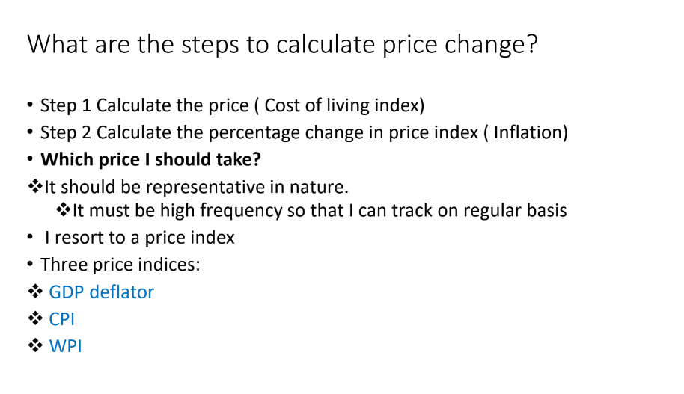

Slide 19
What is CPI?
Consumer Price Index or CPI is the measure of changes in the price level of a basket of consumer goods and services bought by households
The Consumer Price Index or CPI assesses the changes in the price of a common basket of goods and services by comparing with the prices that are prevalent during the same period in a previous year.
The formula for calculating CPI is:
CPI = (Cost of market basket in a given year / Cost of market basket in base year) x 100
Current Base Year for CPI is 2012

Slide 20
It measures price changes from the perspective of a retail buyer. It is released by the National Statistical Office (NSO).
The CPI calculates the difference in the price of commodities and services such as food, medical care, education, electronics etc., which Indian consumers buy for use.
The CPI has several sub-groups including food and beverages, fuel and light, housing and clothing, bedding and footwear.
Four types of CPI are as follows:
CPI for Industrial Workers (CPI - IW).
CPI for Agricultural Labourers (CPI - AL).
CPI for Rural Labourers (CPI - RL)
CPI (Rural/Urban/Combined).

Slide 21
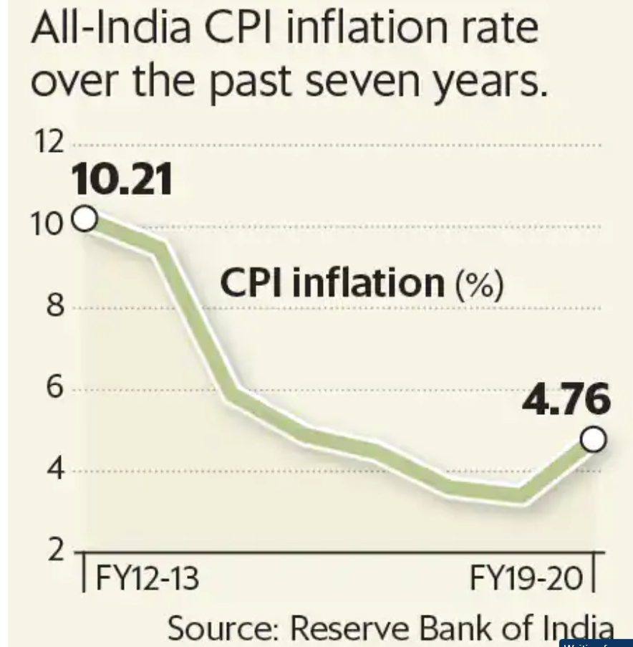

Slide 22
What is Wholesale Price Index?
It measures the changes in the prices of goods sold and traded in bulk by wholesale businesses to other businesses.
Published by the Office of Economic Adviser, Ministry of Commerce and Industry.
It is one of the most widely used inflation indicator in India.
Major criticism for this index is that the general public does not buy products at wholesale price.
The base year of All-India WPI has been revised from 2004-05 to 2011-12 in 2017.

Slide 23
What is the difference between CPI and WPI?
WPI tracks inflation at the producer level and CPI captures changes in prices levels at the consumer level.
WPI does not capture changes in the prices of services, which CPI does.
In WPI, more weightage is given to manufactured goods, while in CPI, more weightage is given to food items.

Slide 24
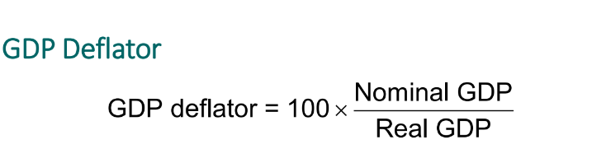

Slide 25
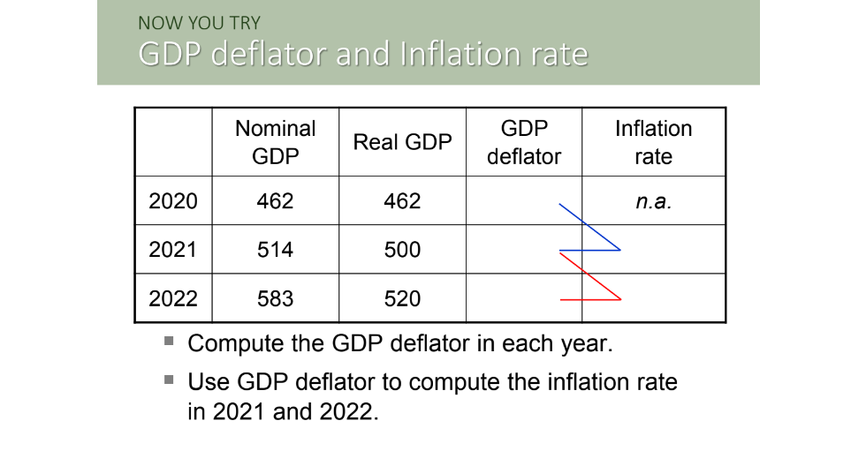

Slide 26
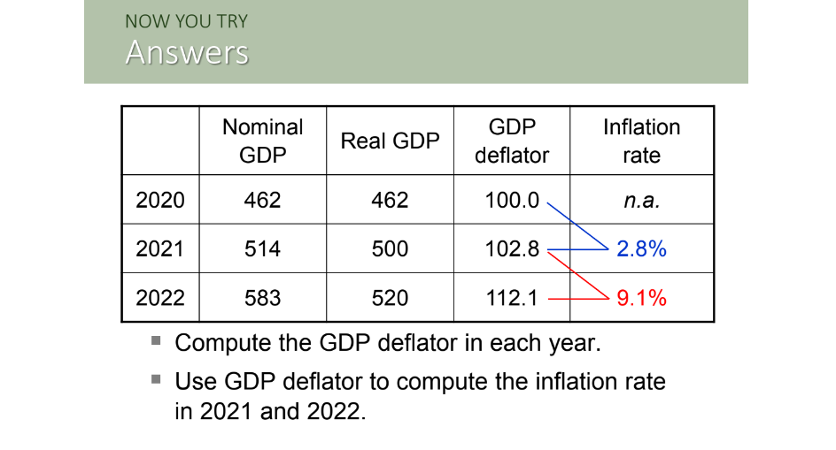

Slide 27
Inflation Targeting in India by RBI
Inflation target of RBI: 4% (+ or – 2) (based on CPI inflation rate)
Upper tolerance level: 6%
Lower tolerance level: 2%

Slide 28
Unemployment

Slide 29
Concepts Of Employment
Employment refers to a situation when a person is able and willing to take up a job and get employed.
The main concepts of Employment are:
1) Full Employment: It refers to a situation where all those workers who are able and willing to work get employment. In full employment, there is optimum utilisation of resources.
2) Under Employment: It refers to a situation when people are engaged in jobs but do not get these jobs according to their abilities, efficiencies and qualification.

Slide 30
Unemployment rate falls to 7.1% in September 2023: CMIE
Unemployment rate in India fell to 7.1 per cent in September 2023 from 8.1 per cent in August, according to CMIE’s Consumer Pyramids Household Survey.
The unemployment rate eased in both rural and urban India.
It came alongside a fall in labour participation rate (LPR). The LPR climbed down from 41.2 per cent in August to 40.9 per cent in September.
While LPR for rural India increased marginally, from 41.6 per cent to 41.8 per cent, urban LPR fell from 40.2 per cent to 39 per cent.

Slide 31
Labour force participation rate in CWS (Current Weekly Status) in urban areas for persons aged 15 years and above increased to 48.8 per cent in April-June 2023, from 47.5 per cent in July-September 2022.
Labour Force refers to the part of the population which supplies or offers to supply labour for pursuing economic activities for the production of goods and services and therefore, includes both employed and unemployed persons.

Slide 32
What is Unemployment?
Unemployment is a situation when a person actively searches for a job and is unable to find work.
Rate of Unemployment is an indicator of the health of an economy.
The unemployment rate is the most frequent measure of unemployment. The unemployment rate is the number of people unemployed divided by the working population or people working under labour force.
Unemployment rate = (Unemployed Workers / Total labour force) × 100

Slide 33
National Sample Survey Organization (NSSO) defines employment and unemployment on the following activity statuses of an individual. NSSO, an organization under MoSPI (Ministry of Statistics and Programme Implementation) measures India’s unemployment rate using three approaches:
1. Daily Status Approach: unemployment status of a person under this approach is measured for each day in a reference week. A person having no gainful work even for one hour in a day is described as unemployed for that day.
2. Weekly Status Approach: This approach highlights the record of those persons who did not have gainful work or were unemployed even for an hour on any day of the week preceding the date of the survey.
3. Usual Status Approach: This gives the estimates of those persons who were unemployed or had no gainful work for a major time during the 365 days.

Slide 34
Types of Unemployment in India
In India, there are seven types of unemployment. They are:
1) Disguised Unemployment: This is a type of unemployment where the number of people employed are more than that is actually needed. Disguised unemployment is generally traced in unorganized sectors or the agricultural sectors.
2) Structural Unemployment: This unemployment arises when there is a mismatch between the worker’s skills and availability of jobs in the market. Many people in India do not get job matching to their skills, or due to lack of required skills or because of poor education levels, they do not get suitable jobs.
3) Seasonal Unemployment: That situation of unemployment when people do not have work during certain seasons of the year, such as labourers in agricultural sector in India rarely have occupation throughout the year.
4) Vulnerable Unemployment: People are deemed to be unemployed under this type of unemployment even if they’re working. People are employed but informally i.e. without proper job contracts and thus records of their work are never maintained. It is one of the main types of unemployment in India.

Slide 35
5) Technological Unemployment: the situation when people lose their jobs due to advancement in technologies. In 2016, the data of the World Bank predicted that the proportion of jobs threatened by automation in India is 69% year-on-year.
6) Cyclical Unemployment: unemployment caused due to the business cycle, where the number of unemployed heads rises during recessions and declines with the growth of the economy. Cyclical unemployment figures in India are negligible.
7) Frictional Unemployment: this is a situation when people are unemployed for a short span of time while searching for a new job or switching between jobs. Frictional Unemployment also called Search Unemployment, is the time lag between the jobs. Frictional unemployment is considered as voluntary unemployment because the reason for unemployment is not a shortage of jobs, but in fact, the workers themselves quit their jobs in search of better opportunities.

Slide 36
Causes of Unemployment
The major causes of unemployment in India are as mentioned below:
Large population.
Lack of vocational skills or low educational levels of the working population.
Labour-intensive sectors suffering from the slowdown in private investment particularly after demonetization
The low productivity in the agriculture sector plus the lack of alternative opportunities for agricultural workers that makes transition among the three sectors difficult.
Legal complexities, Inadequate state support, low infrastructural, financial and market linkages to small businesses making such enterprises unviable with cost and compliance overruns.
Inadequate growth of infrastructure and low investments in the manufacturing sector, hence restricting the employment potential of the secondary sector.
The huge workforce of the country is associated with the informal sector because of a lack of required education or skills, and this data is not captured in employment statistics.
The main cause of structural unemployment is the education provided in schools and colleges are not as per the current requirements of the industries.
Regressive social norms that deter women from taking/continuing employment.

Slide 37
Impact of Unemployment
The unemployment in any nation have the following effects on the economy:
The problem of unemployment gives rise to the problem of poverty.
The government suffers extra borrowing burden because unemployment causes a decrease in the production and less consumption of goods and services by the people.
Unemployed persons can easily be enticed by antisocial elements. This makes them lose faith in the democratic values of the country.
People unemployed for a long time may indulge in illegal and wrong activities for earning money which increases crime in the country.
Unemployment affects the economy of the country as the workforce that could have been gainfully employed to generate resources actually gets dependent on the remaining working population, thus escalating socio-economic costs for the state. For instance, a 1 % increase in unemployment reduces the GDP by 2 %.
It is often seen that unemployed people end up getting addicted to drugs and alcohol or attempts suicide, leading to losses to the human resources of the country.

Slide 38
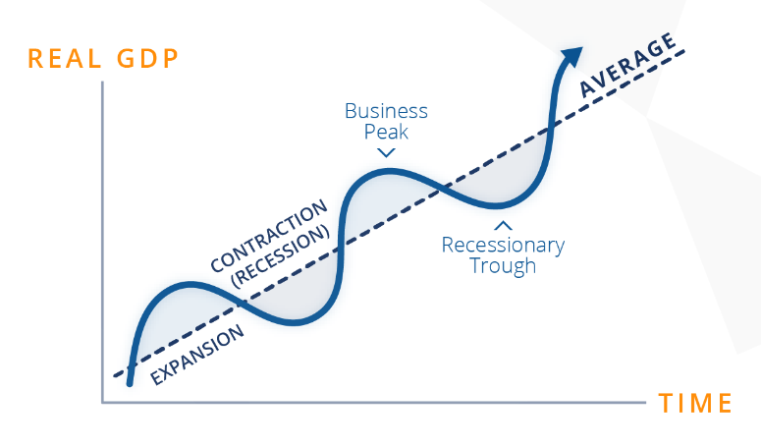
Business Cycle..?
A cycle of expansion and contraction that economies undergo over time.

Slide 39
Q1. Unemployment that occurs during the normal workings of an economy as people change jobs and move across the country is called _____?
structural unemployment.
natural unemployment
frictional unemployment
cyclical unemployment

Slide 40
Answer to Q1 - (3) Frictional unemployment
Q2. The natural rate of unemployment is generally thought of as the:
the sum of frictional unemployment and structural unemployment
the ratio of the frictional unemployment rate to the cyclical unemployment rate
the sum of frictional unemployment and cyclical unemployment
the sum of structural unemployment and cyclical unemployment

Slide 41
Answer to Q2 - (1) the sum of frictional unemployment and structural unemployment.
Q3. A sales manager of an equipment manufacturing company loses his job because the company relocated the unit to another country is an example of ____ unemployment.
Seasonal unemployment
Frictional unemployment
Cyclical unemployment
Structural unemployment

Slide 42
Answer to Q3 - (4) Structural unemployment
Q4. When the rate of unemployment increases because of recession or depression in the economy, it is classified as which type of unemployment?
Structural unemployment
Seasonal unemployment
Cyclical Unemployment
Frictional Unemployment

Slide 43
Answer to Q4 - (3) Cyclical Unemployment
Q5. Discouraged workers are not considered as a part of the labour force, so classifying them as unemployed would:
have an indeterminate impact on the unemployment rate
not change the unemployment rate
increase the unemployment rate
decrease the unemployment rate
Answer to Q5 - (3) increase the unemployment rate

Slide 44
Concepts related to Inflation & Unemployment:
Business Cycles, Phillips Curve,
Okun’s Law

Slide 45
What Is a Business Cycle?
Business cycles are a type of fluctuation found in the aggregate economic activity of a nation -- a cycle that consists of expansions occurring at about the same time in many economic activities, followed by similarly general contractions (recessions).

Slide 46
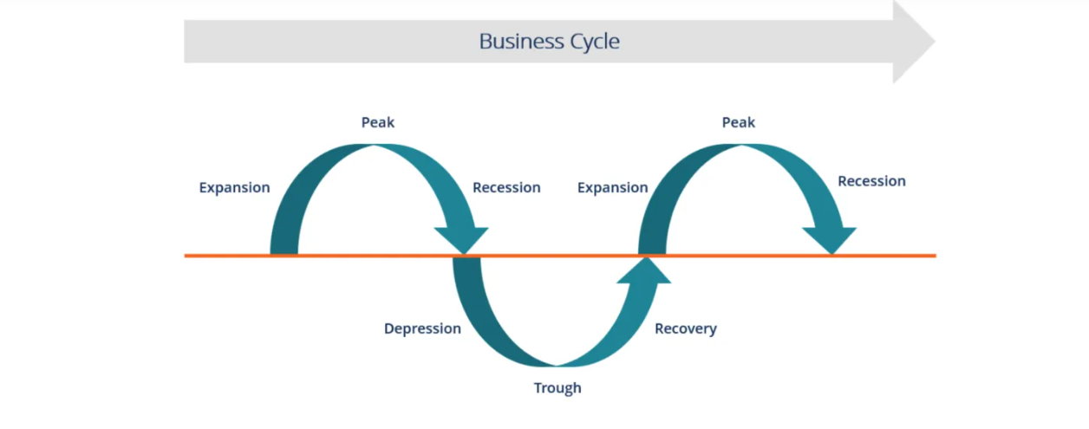
A business cycle is a cycle of fluctuations in the Gross Domestic Product (GDP) around its long-term natural growth rate. It explains the expansion and contraction in economic activity that an economy experiences over time.

Slide 47
A business cycle is completed when it goes through a single boom and a single contraction in sequence. The time period to complete this sequence is called the length of the business cycle.
A boom is characterized by a period of rapid economic growth whereas a period of relatively stagnated economic growth is a recession.

Slide 48
Stages of the Business Cycle
In the diagram above, the straight line in the middle is the steady growth line. The business cycle moves through the line. Below is a more detailed description of each stage in the business cycle:
1. Expansion
The first stage in the business cycle is expansion. In this stage, there is an increase in positive economic indicators such as employment, income, output, wages, profits, demand, and supply of goods and services. Debtors are generally paying their debts on time, the velocity of the money supply is high, and investment is high. This process continues as long as economic conditions are favorable for expansion.

Slide 49
2. Peak
The economy then reaches a saturation point, or peak, which is the second stage of the business cycle. The maximum limit of growth is attained. The economic indicators do not grow further and are at their highest. Prices are at their peak. This stage marks the reversal point in the trend of economic growth. Consumers tend to restructure their budgets at this point.
3. Recession
The recession is the stage that follows the peak phase. The demand for goods and services starts declining rapidly and steadily in this phase. Producers do not notice the decrease in demand instantly and go on producing, which creates a situation of excess supply in the market. Prices tend to fall. All positive economic indicators such as income, output, wages, etc., consequently start to fall.

Slide 50
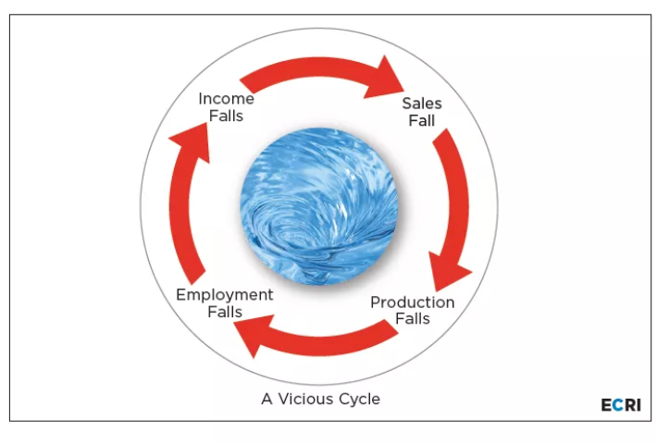
What is Recession ?

Slide 51
4. Depression
There is a commensurate rise in unemployment. The growth in the economy continues to decline, and as this falls below the steady growth line, the stage is called a depression.
5. Trough
In the depression stage, the economy’s growth rate becomes negative. There is further decline until the prices of factors, as well as the demand and supply of goods and services, contract and reach their lowest point. The economy eventually reaches to trough. It is the negative saturation point for an economy. There is extensive depletion of national income and expenditure.

Slide 52
6. Recovery
After the trough, the economy moves to the stage of recovery. In this phase, there is a turnaround in the economy, and it begins to recover from the negative growth rate. Demand starts to pick up due to low prices and, consequently, supply begins to increase. The population develops a positive attitude towards investment and, employment and production starts increasing.

Slide 53
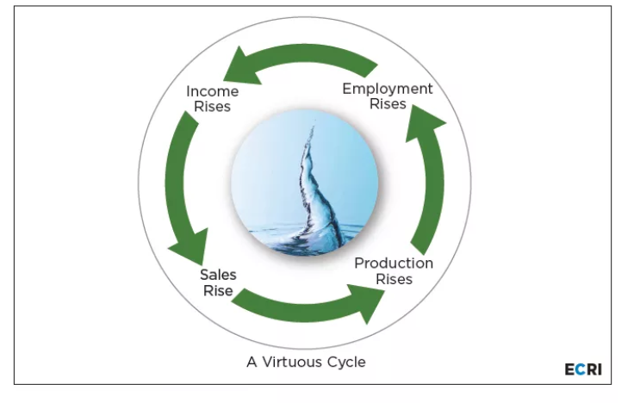
What is Recovery?

Slide 54
The Phillips Curve
The Phillips curve examines the inverse relationship between money, wage rates and rate of unemployment.
This relation was first identified by the British economist A W Phillips from data relating to the period from 1861 to 1957.
The Phillips curve is a downward sloping curve which indicates that the money wage rate is inversely related to the unemployment rate, that is - Unemployment rates are accompanied by lower money wage rates.

Slide 55
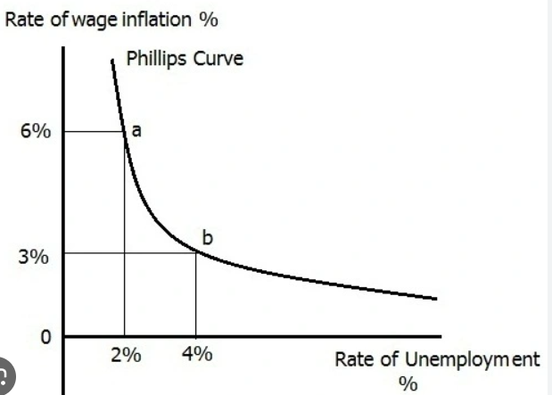

Slide 56
There are two explanations for the inverse relationship depicted in the Phillips curve.
Behavior of Organized Labour.
Organized labour (trade unions) can push up the wages above labor productivity resulting in wage push inflation. The extent to which labor unions can do this will vary inversely with the unemployment percentage and the ease of labor markets.
With lower unemployment, labor unions will demand larger wage increase. Excessive wage increase demands will be granted by the businessmen because times of low unemployment are characterized by high profit.

Slide 57
(2) Excess Demand for Labor
With a given labour supply, the amount of unemployment will vary inversely with the amount of excess demand.
Excess demand for labour will result in an increase in money wages and a reduction in unemployment.
Thus there is an inverse relationship between money wage rate and the rate of unemployment as shown by Phillips curve.

Slide 58
Trade-off Between Inflation and Unemployment
The original Phillips curve depicts the inverse relationship between money wage rates and unemployment rates. The modified Phillips Curve shows an inverse relation between inflation and unemployment.
A. W. Phillips found that a high rate of unemployment was associated with a low rate of inflation.

Slide 59
Okun’s Law
Okun's Law looks at the statistical relationship between GDP and unemployment. Okun's Law can also be used to estimate gross national product (GNP).
Okun's law is an observed relationship between a country's GDP (or GNP) and employment levels.
Okun's law was coined by Arthur Okun, a Yale economist who served on President Kennedy's council of economic advisors.

Slide 60
Okun's law predicts that a 1% drop in employment tends to be accompanied by a drop in GDP of around 2%. Likewise, a 1% increase in employment is associated with a 2% GDP increase.
Okun's Law is an empirically observed relationship between unemployment and losses in a country's production. It predicts that a 1% increase in unemployment will usually be associated with a 2% drop in gross domestic product (GDP).
Okun's law is not without controversy, and some economists disagree about the exact relationship between employment and productivity.
Although Okun's law is not derived from any theoretical prediction, observational data indicates that Okun's law often holds true.

